Slide 1
Queue system
By Shyam Mourouguessane

Slide 2
What is it?
There will be a master micro:bit at the counter and the customers that order the food will receive a micro:bit with a number on it after it was registered on the master micro:bit. Through the master micro:bit , they can make the other micro:bit buzz once the food is ready and it will continue to buzz until the food is collected and is returned to the counter.

Slide 3
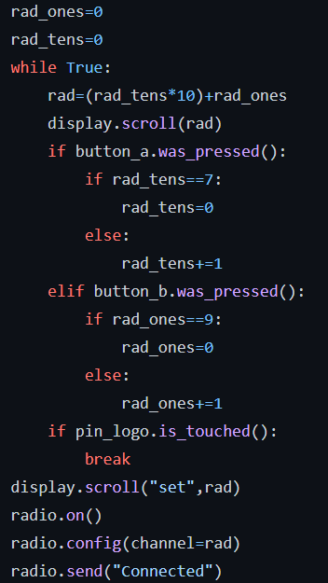
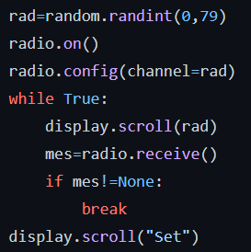
How it works
Firstly the receiving micro:bit will generate a random number from 0 to 79 and will set its radio as according.
Then the sending microbit will display a number and the it will be manually set to match the other micro:bit by pressing button b to increase the tens digit by 1 and button a to increase the one digit by 1 and when the logo is touched, the number will be pressed

Slide 4
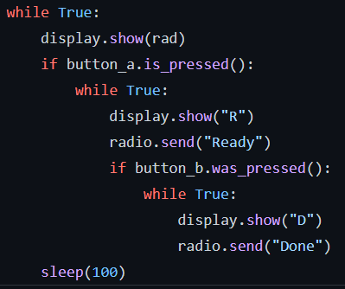
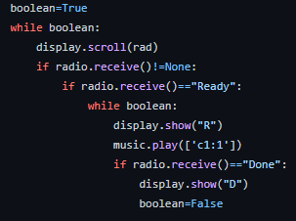
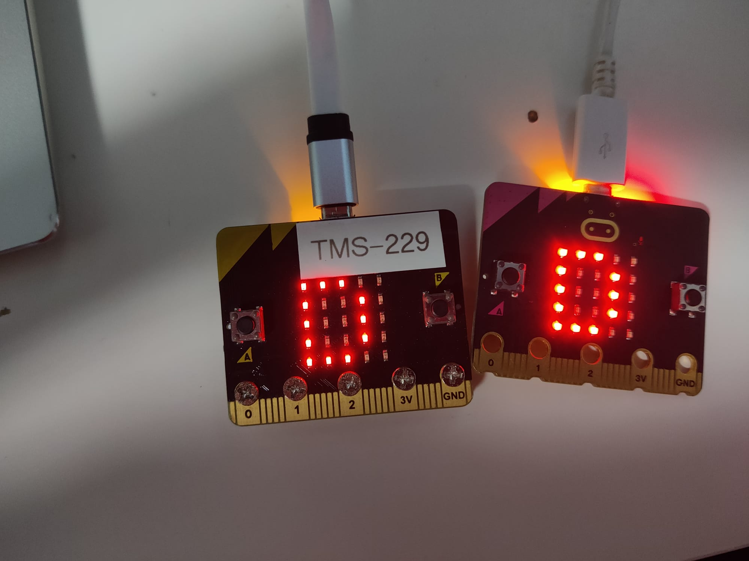
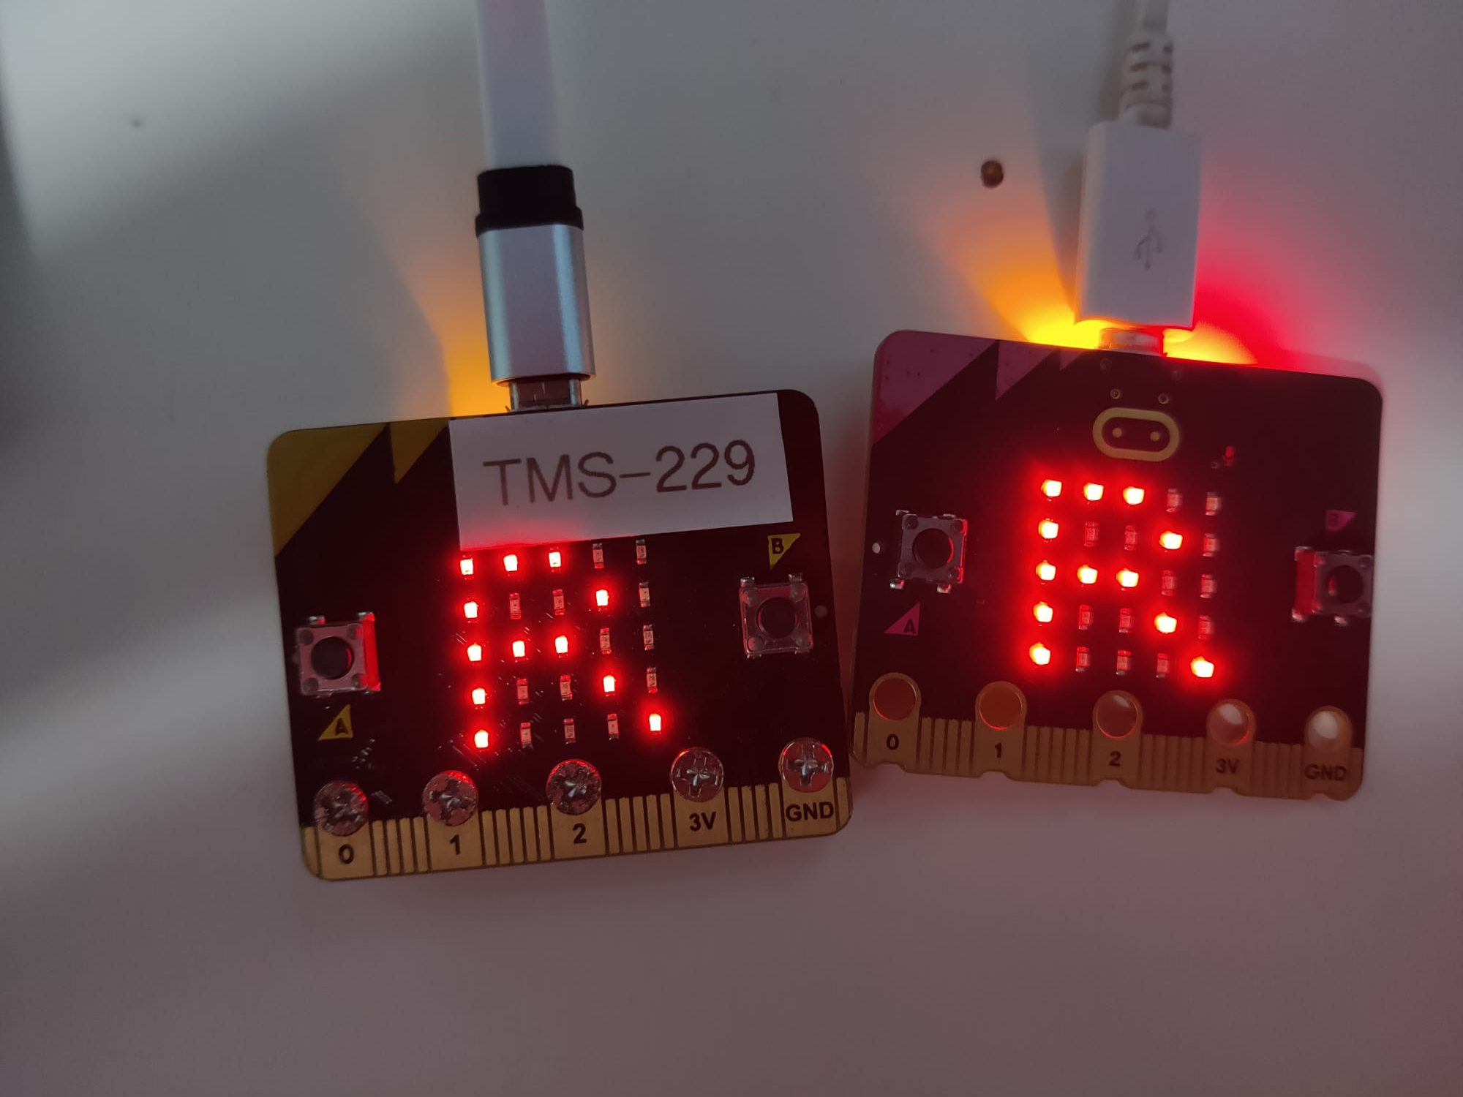
How it works
When button a is pressed on the master micro:bit, it will send the message “Ready” through the radio and when received, both the microbit’s will display “R”(ready) on the displays and the receiving end will sound a buzzer.
When button b ispressed after words, the message “Done” is sent through the radio and “D” is display and when the receiving micro:bit gets the message, it stops buzzing and it will display a “D”(done).And when the reset button is pressed on both the microbits they can be used again.

Slide 5
Some Issues faced & ways to improve
A)Some of the issues that was faced includes the logo of the version two getting dirty easily which results in the sensor being activated and as a result, it needs to be wiped after every few uses.
Additionally when I was testing it, there will be a big latency of between the communication of the micro:bits
B)Some improvements to add is allowing the micro:bit to switch between different micro:bits so that only one master token will be needed even if there are more than one customers.
In addition to that allowing there to be more than 80 costumes by changing the power oof the radio signals as well as the radio frequency.

Slide 6
Thank
You!

